Slide 1
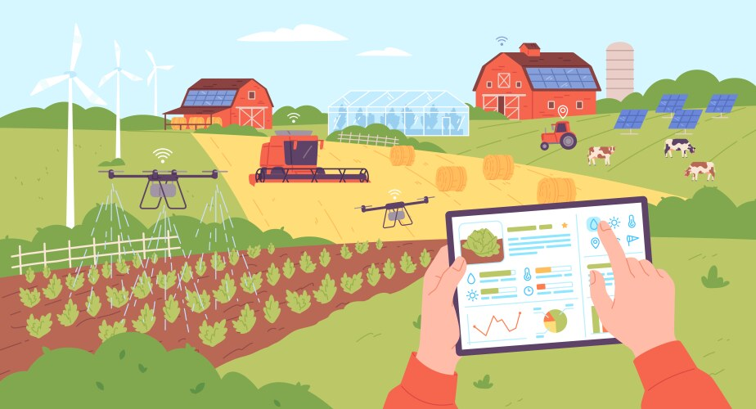
Agro-Tech Hub Final Project Defense
Team Members: Parash Parajuli
Subash Poudel
Nishchal Sharma

Slide 2

Introduction
Agriculture is Nepal’s economic backbone.
Farmers face problems like poor access to markets, outdated practices, and low tech usage.
Agro-Tech Hub aims to bridge traditional farming with digital innovation.
Uses tools like mobile apps, AI, and data analytics.

Slide 3
Problem Statement
High costs of tech tools.
Lack of awareness and training.
Complicated tech systems.
Lacks interaction with the experts digitally.

Slide 4
Background Study
Nepalese farmers use outdated methods due to poor resources.
Existing tools are not localized or user-friendly.
Agro-Tech Hub will be a centralized, accessible platform for all farming needs.

Slide 5
Objectives
Provide a localized digital tool for farmers.
Offer real-time AI farming advice.
Facilitate direct buyer-farmer interaction.
Promote community learning and sustainable practices.

Slide 6
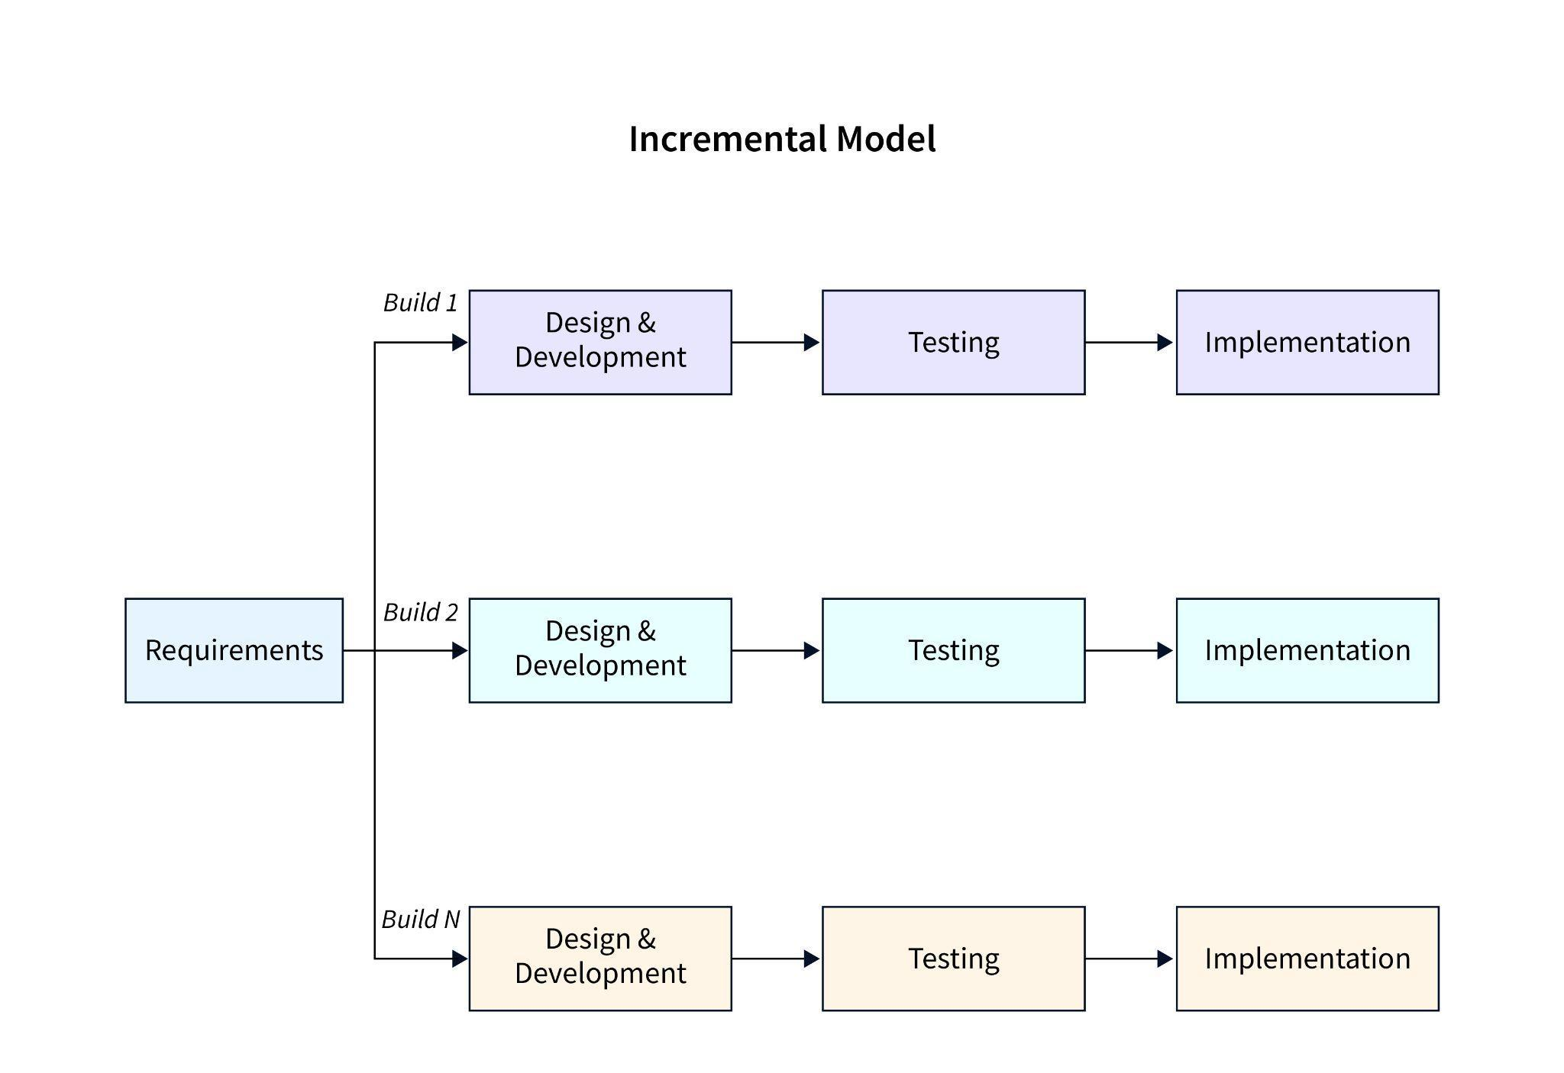
Methodology
Incremental Model used for software development.
Delivers features step-by-step with early feedback.
Reduces risks and allows adaptability.
Suitable for evolving requirements.

Slide 7
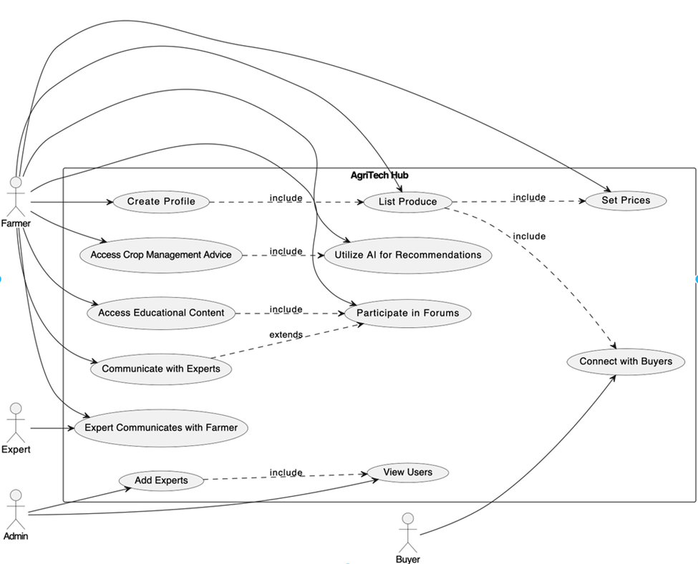
Block Diagram

Slide 8
Deliverables
Mobile App: Offline/online, farmer-friendly.
AI Advisory System: Personalized crop/weather advice.
Market Linkage: Connects farmers with buyers.
Community Forum: Comments, success stories, peer support.
Experts Engagement: Suggestions and advices to farmers from experts.
Notes:
A simple and easy-to-use app made for farmers. It works even without internet and supports local languages.
A smart system that gives farmers personalized tips about crops and weather, helping them make better farming decisions.
Connects farmers directly with buyers, so they can sell their products at fair prices without middlemen.
A space where farmers can share their experiences, ask questions, and learn from each other’s success stories.
Experts in farming can give advice, answer questions, and guide farmers to improve their practices.

Slide 9
Limitations
The platform is easy to use but the local farmers may find it difficult though.
Local language support may not be included.

Slide 10
Future Enhancemets:
..

Slide 11
Future Enhancemets:
..

Slide 12
Conclusion
Agro-Tech Hub addresses core challenges in Nepalese farming.
Aims to empower farmers with information, tools, and networks.
Promotes sustainable agriculture and better income.
A step towards a tech-driven agricultural future.

Slide 13
THANK YOU !

